Slide 1
Diaster Recovery with IBM Project
Arockia Antony Luvin.A

Slide 2
Step:1
Creating a Website model
Set the confusion.

Slide 3
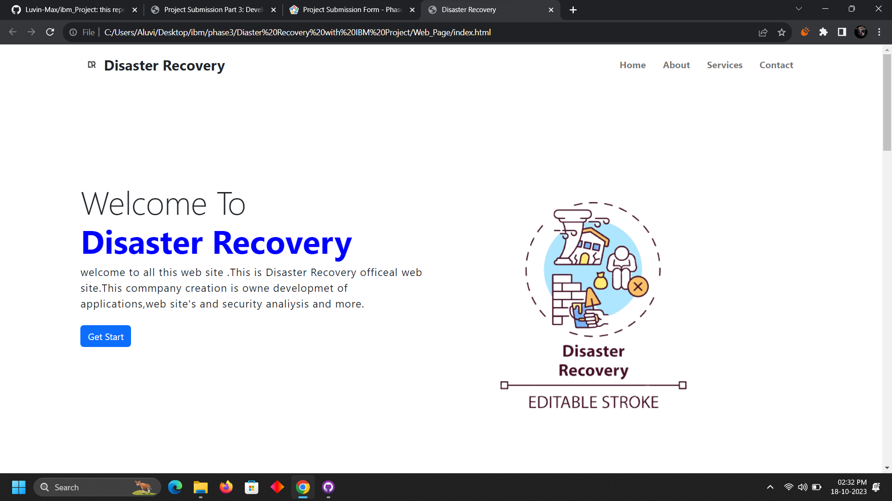

Slide 4
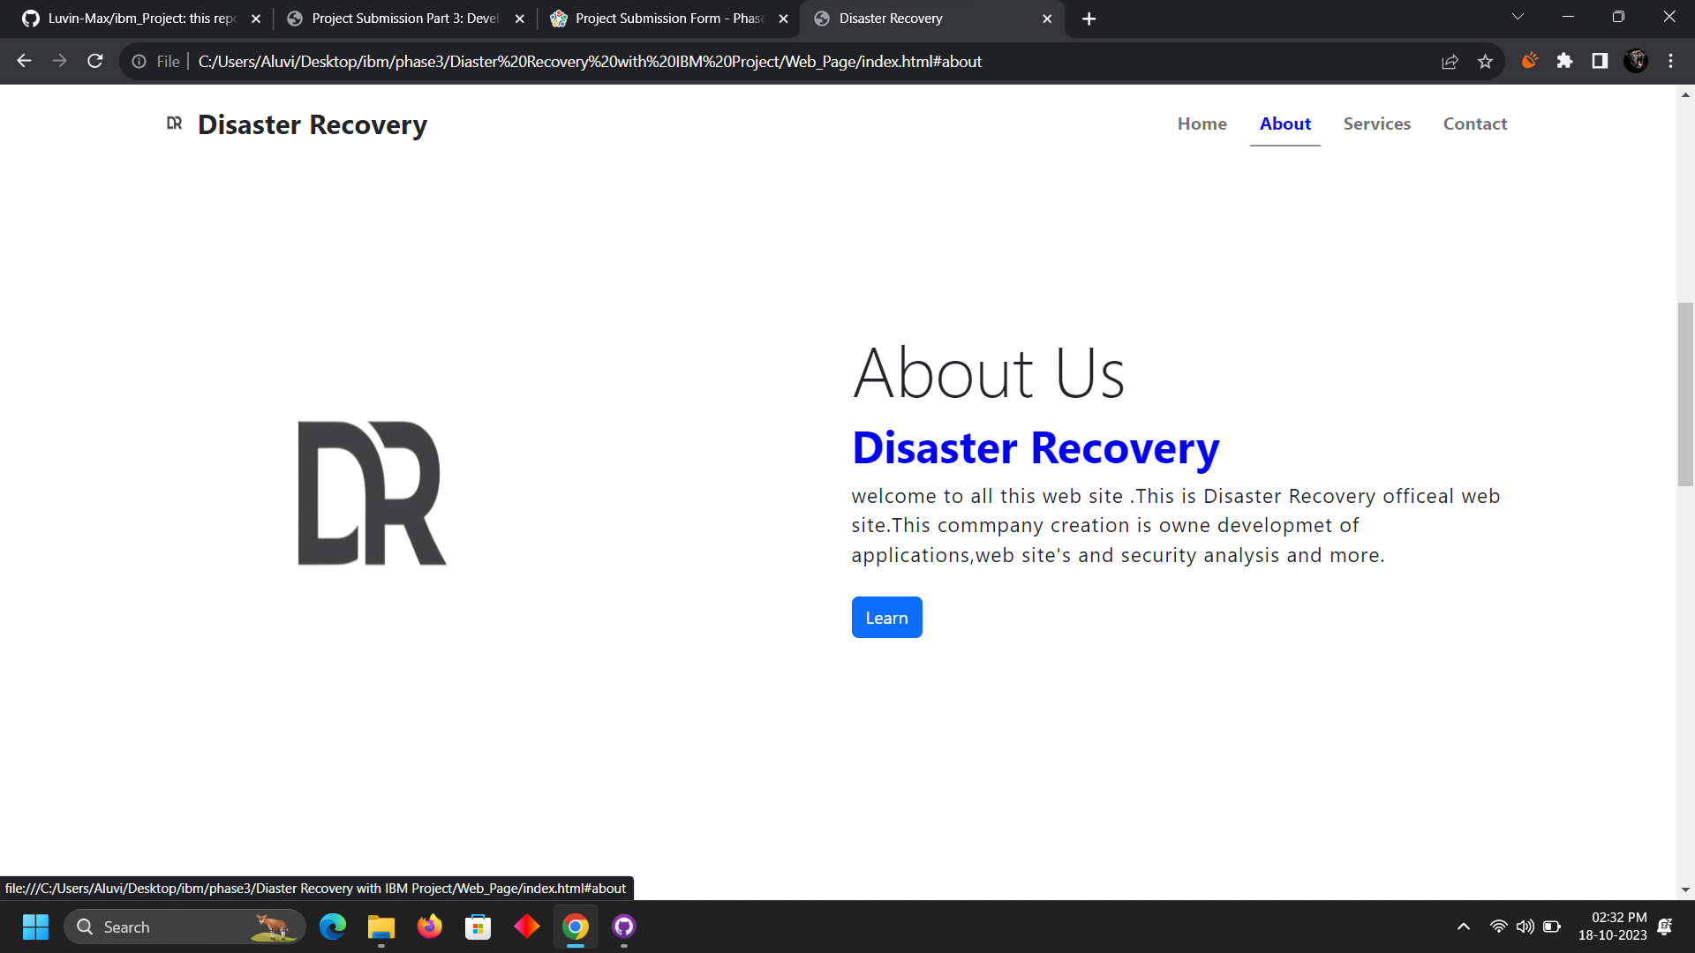

Slide 5
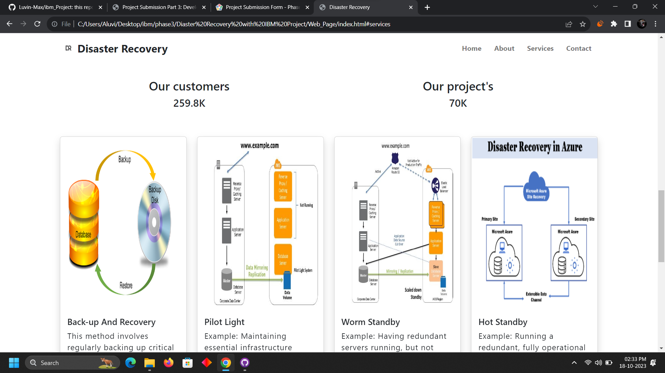

Slide 6
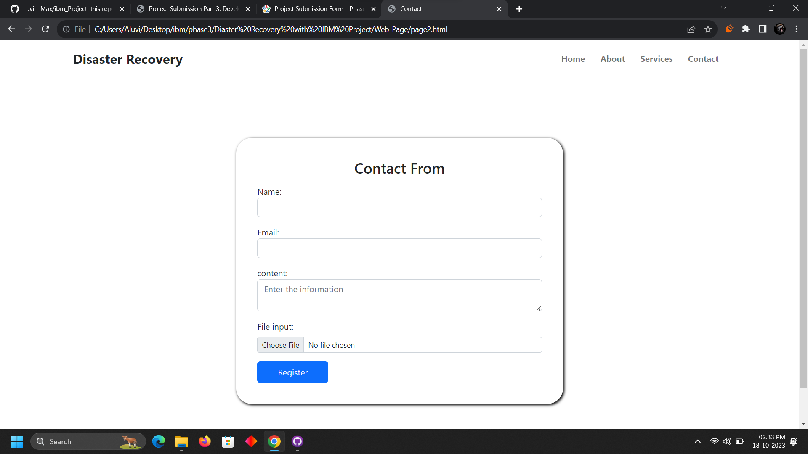

Slide 7
Step:2
Creating connections with flask

Slide 8
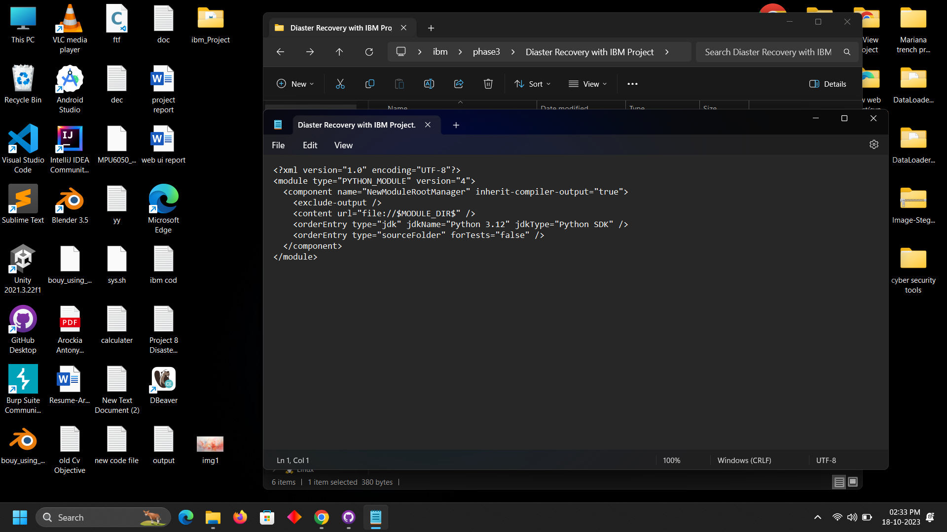

Slide 9
Step:3
Creating Data displaying table layout
And Data collection table also must
That’s a finding tool to find a problem which area

Slide 10
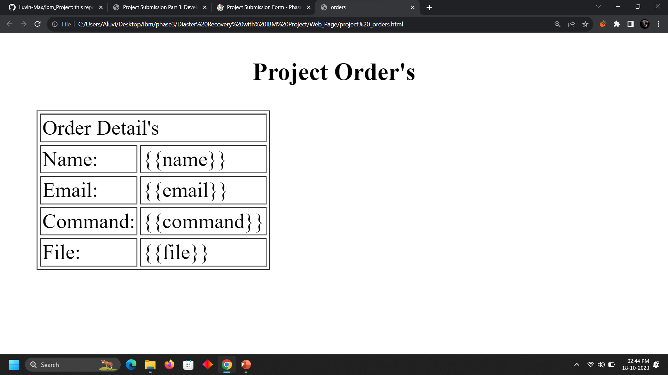

Slide 11
Step:4
Create a Connection to the flask and web page
Then route the all functions.
Next data base connection db2

Slide 12
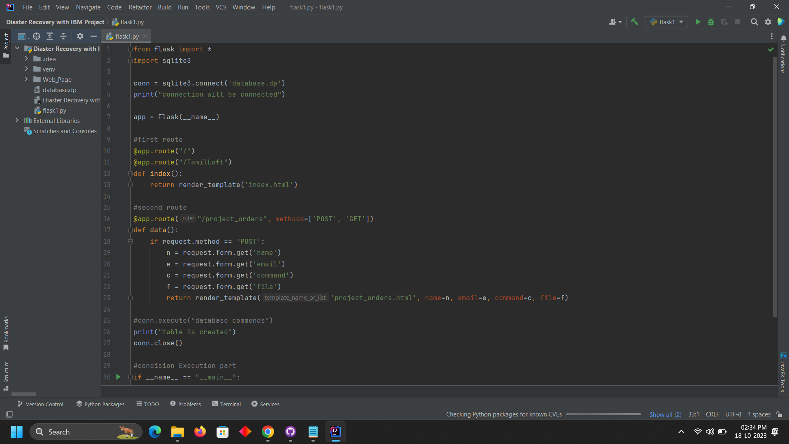

Slide 13
Thank you
Arockia Antony Luvin
A.luvin20@gmail.com
8925356605

